Slide 1
Artificial Bee Colony Optimization and Investment Strategy
Speaker: 林奇鋒
Reference: An Idea Based On Honey Bee Swarm For Numerical Optimization

Slide 2
Initialize Population
Place the employed bees on their food sources
Place the onlooker bees on the food sources depending on their nectar amounts
Send the scouts to the search area for discovering new food sources
Memorize the best food source found so far
Stop?
End
No
Yes

Slide 3
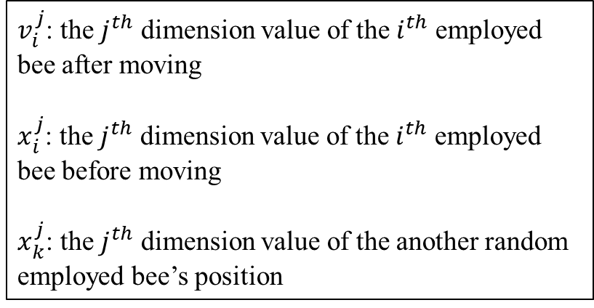
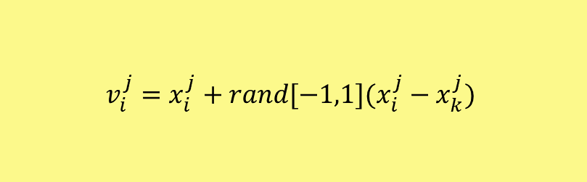
Initialize Population
Place the employed bees on their food sources
$$v_{i}^{j}=x_{i}^{j}+rand[−1,1](x_{i}^{j}−x_{k}^{j})$$
$v_{i}^{j}$: the $j^{th}$ dimension value of the $i^{th}$ employed bee after moving
$x_{i}^{j}$: the $j^{th}$ dimension value of the $i^{th}$ employed bee before moving
$x_{k}^{j}$: the $j^{th}$ dimension value of the another random employed bee’s position

Slide 4
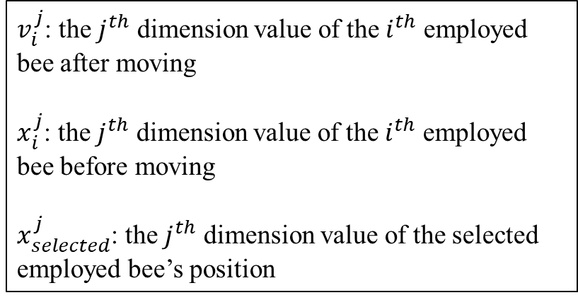
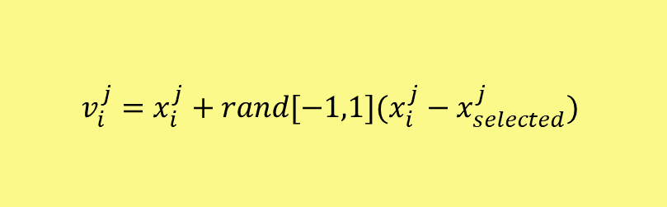
Initialize Population
Place the employed bees on their food sources
$$v_{i}^{j}=x_{i}^{j}+rand[−1,1](x_{i}^{j}−x_{selected}^{j})$$
Place the onlooker bees on the food sources depending on their nectar amounts
$v_{i}^{j}$: the $j^{th}$ dimension value of the $i^{th}$ employed bee after moving
$x_{i}^{j}$: the $j^{th}$ dimension value of the $i^{th}$ employed bee before moving
$x_{selected}^{j}$: the $j^{th}$ dimension value of the selected employed bee’s position

Slide 5
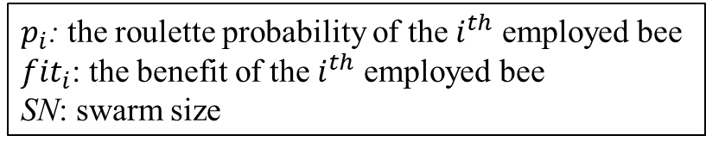

Initialize Population
Place the employed bees on their food sources
$$p_{i}=\frac{fit_{i}}{\sum_{n=1}^{SN}{fit_{n}}}$$
Place the onlooker bees on the food sources depending on their nectar amounts
$p_{i}$: the roulette probability of the $i^{th}$ employed bee
${fit}_{i}$: the benefit of the $i^{th}$ employed bee
SN: swarm size

Slide 6
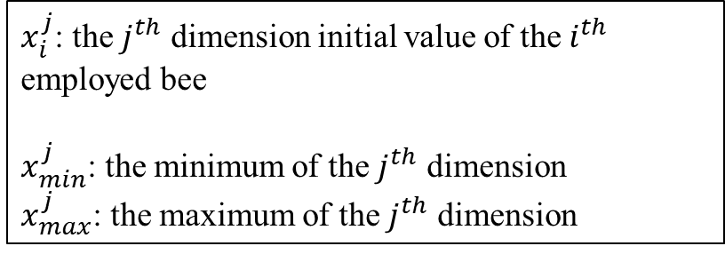
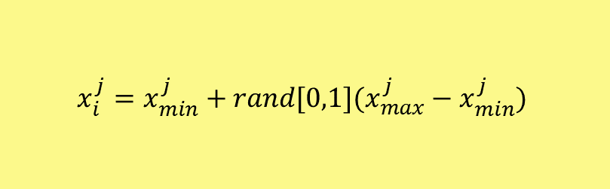
Initialize Population
Place the employed bees on their food sources
$$x_{i}^{j}=x_{min}^{j}+rand[0,1](x_{max}^{j}−x_{min}^{j})$$
Place the onlooker bees on the food sources depending on their nectar amounts
$x_{i}^{j}$: the $j^{th}$ dimension initial value of the $i^{th}$ employed bee
$x_{min}^{j}$: the minimum of the $j^{th}$ dimension
$x_{max}^{j}$: the maximum of the $j^{th}$ dimension
Send the scouts to the search area for discovering new food sources
*In my study, I use the 20% overall iteration as the limit of each employed bee.

Slide 7
Initialize Population
Place the employed bees on their food sources
Place the onlooker bees on the food sources depending on their nectar amounts
Send the scouts to the search area for discovering new food sources
Memorize the best food source found so far
Stop?
End
No
Yes

Slide 8

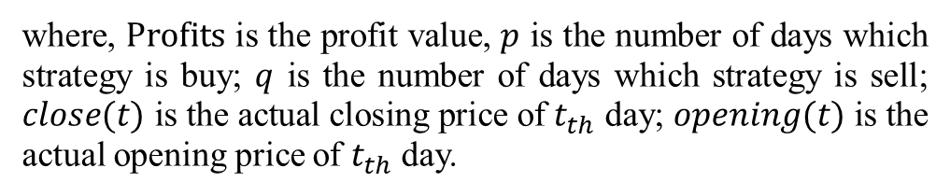
Investment Strategy
$$Profits=\sum_{t_{b}=1}^{p}{\left(close\left(t\right)−open\left(t\right)\right)+}\sum_{t_{s}=1}^{q}{\left(open\left(t\right)−close\left(t\right)\right)}$$
where, $Profits$ is the profit value, $p$ is the number of days which strategy is buy; $q$ is the number of days which strategy is sell; $close(t)$ is the actual closing price of $t_{th}$ day; $opening(t)$ is the actual opening price of $t_{th}$ day.

Slide 9
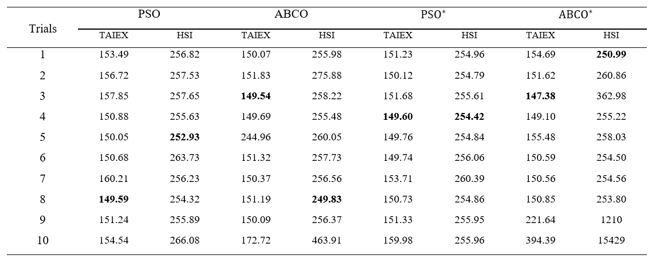
Result (RMSE)

Slide 10
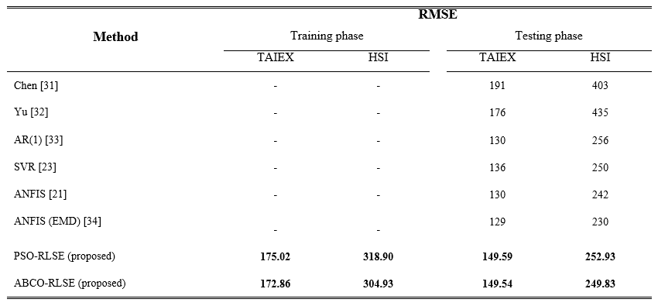
Result (RMSE)

Slide 11
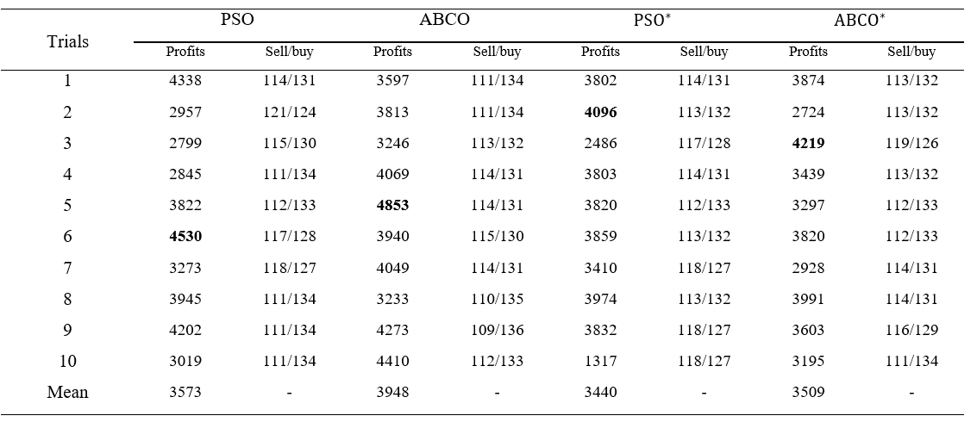
Simulation of Investment Strategy

Slide 12
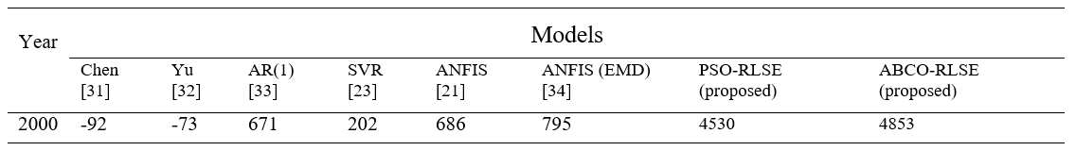
Simulation of Investment Strategy

